Slide 1
Optimizing and Interacting with Information Visualizations Using Topological Data Analysis
Paul Rosen Associate Professor University of South Florida
Download Demo @
https://github.com/USFDataVisualization/tdv_workshop_2022/archive/refs/tags/v1.0.2.zip

Slide 2
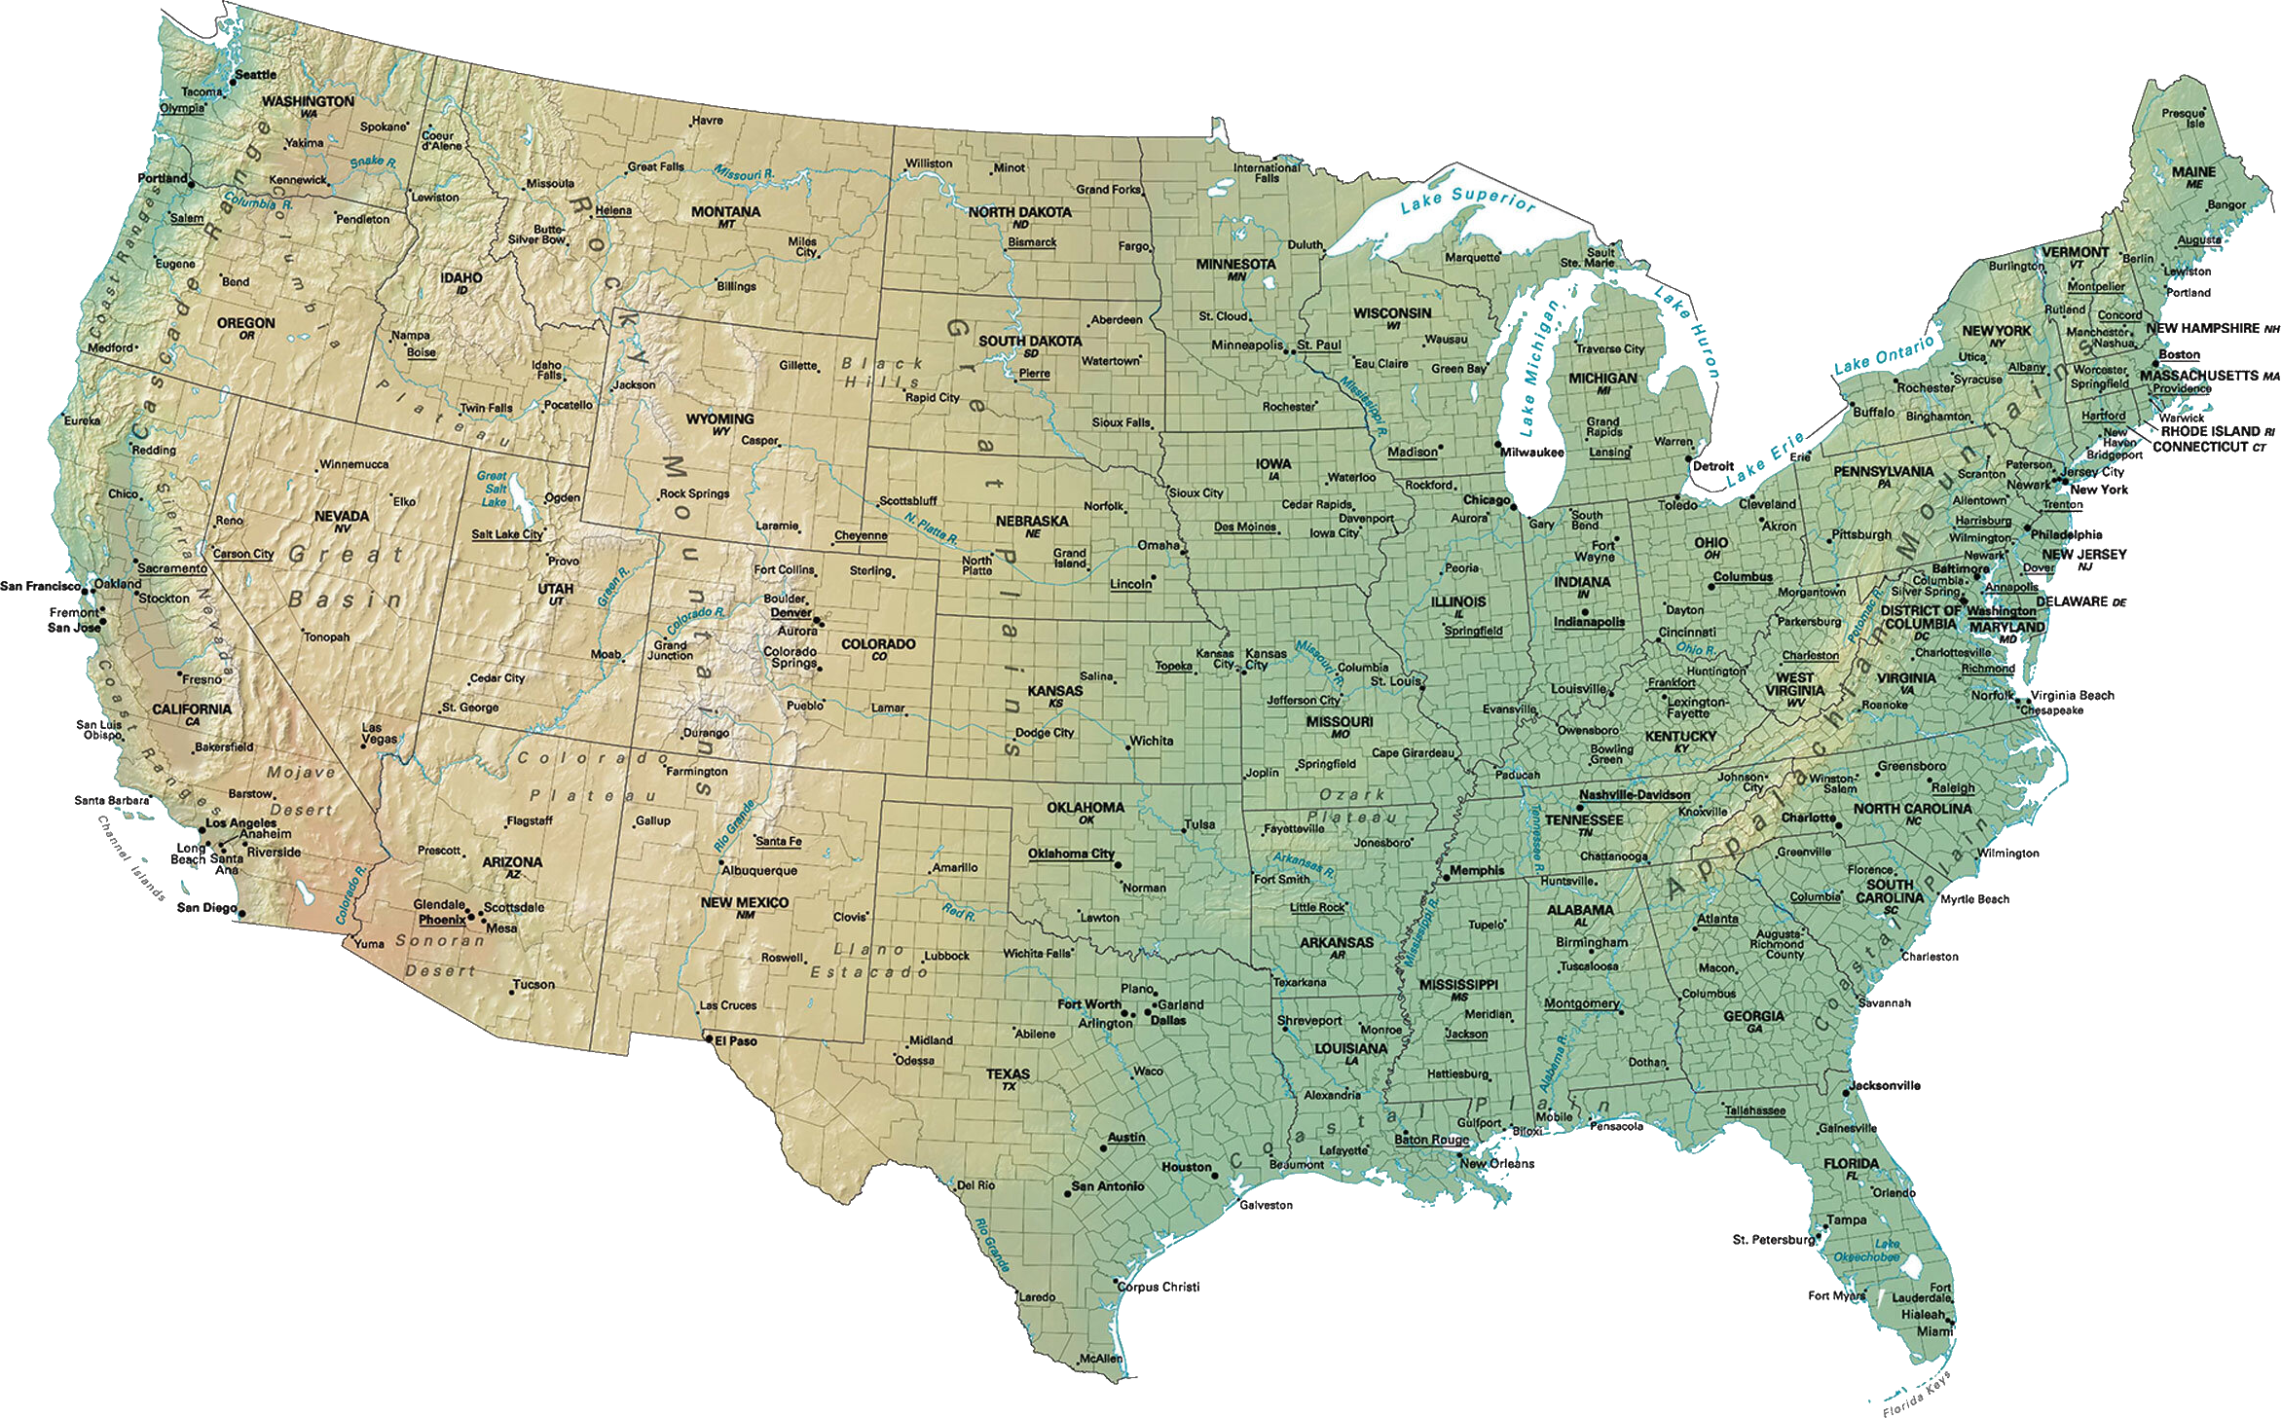




About me
a

Slide 3
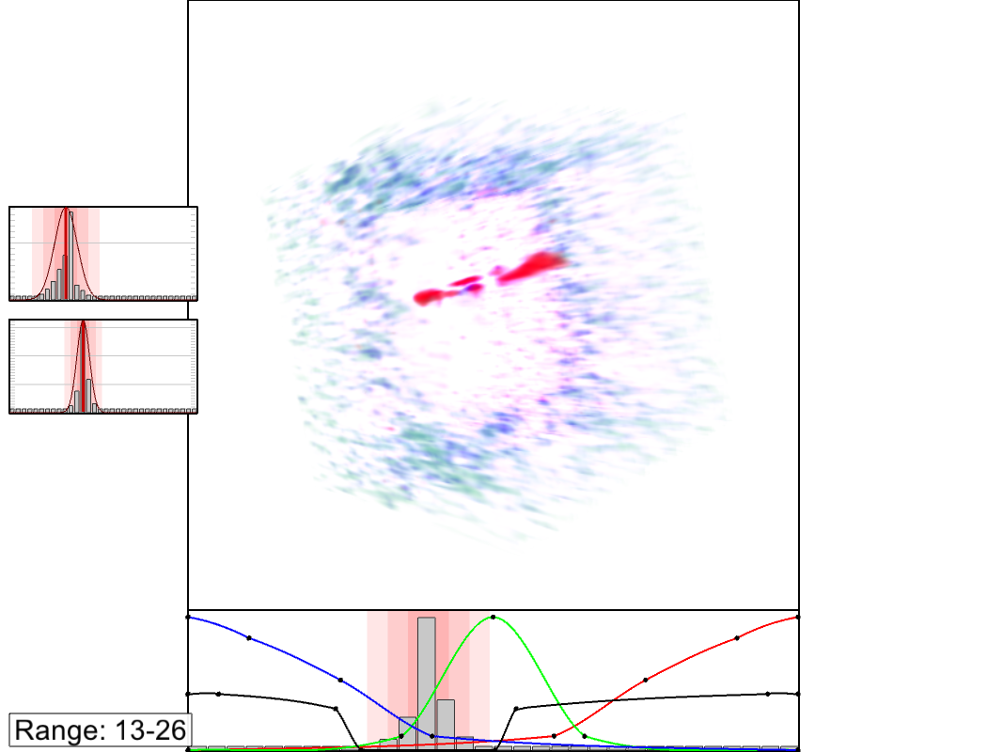
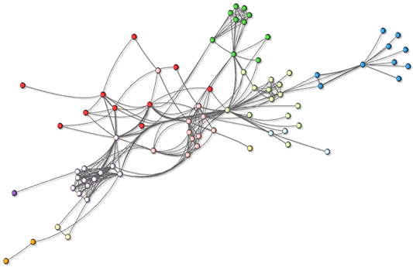
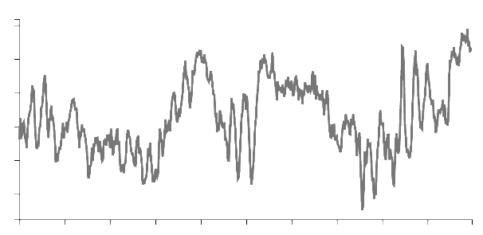
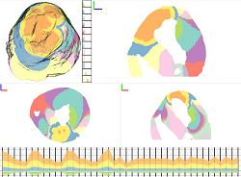
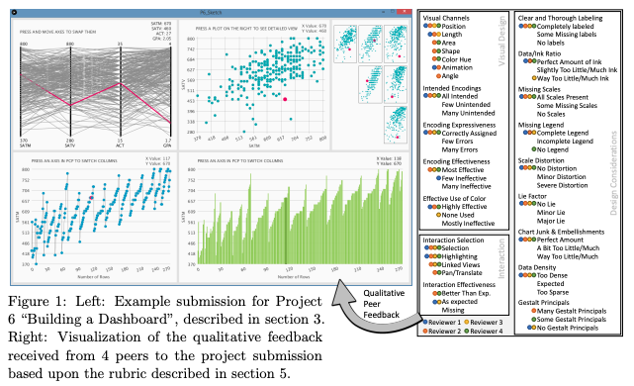
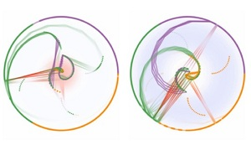
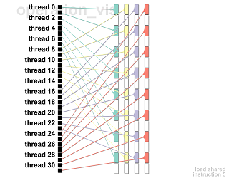
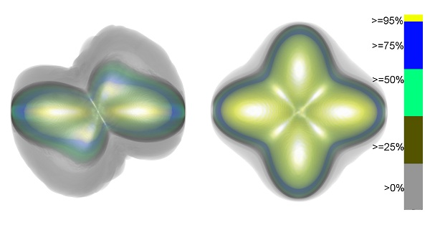
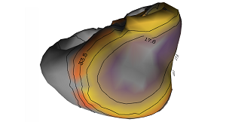
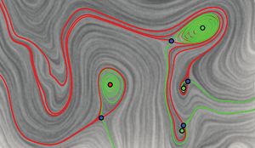


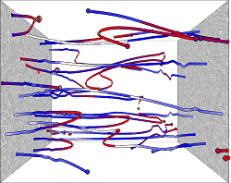
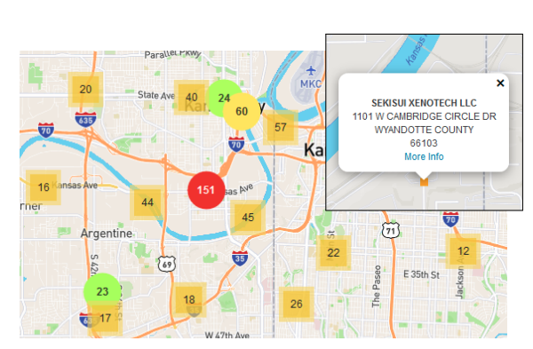
Scalar Field Visualization
Visualization Design
Graph Visualization
Uncertainty Visualization
Visualization
Education
Software Visualization
Air Quality and Asthma Management
Vector Field Visualization

Slide 4
TopoCLuster: Optimizing Cluster Perception in Scatterplots using TDA

Slide 5
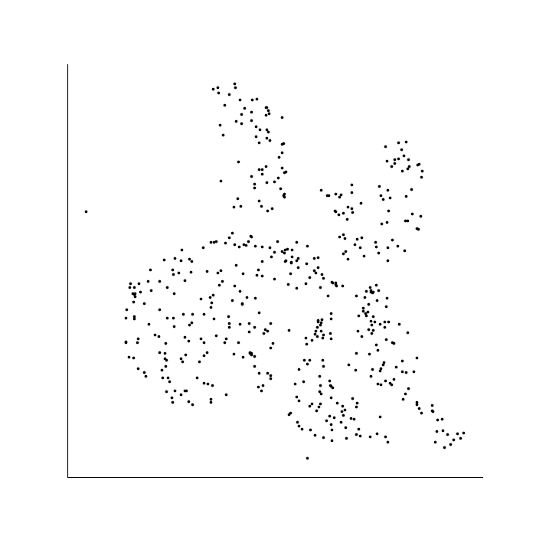
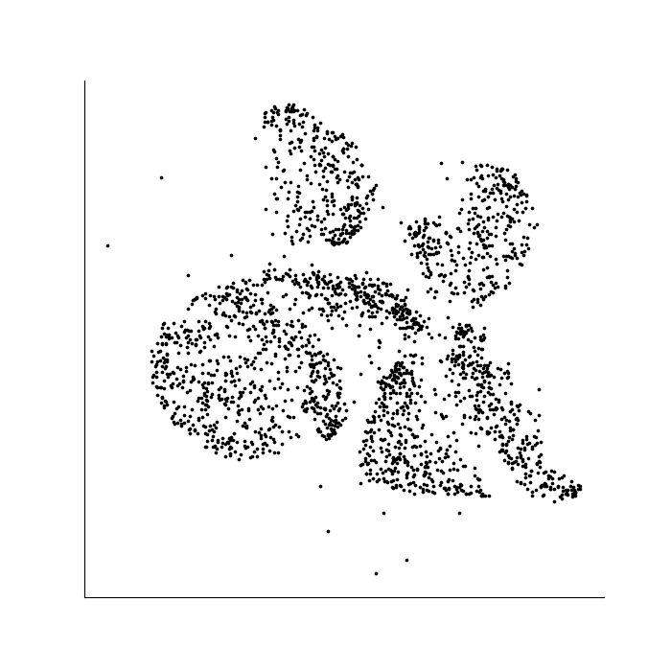
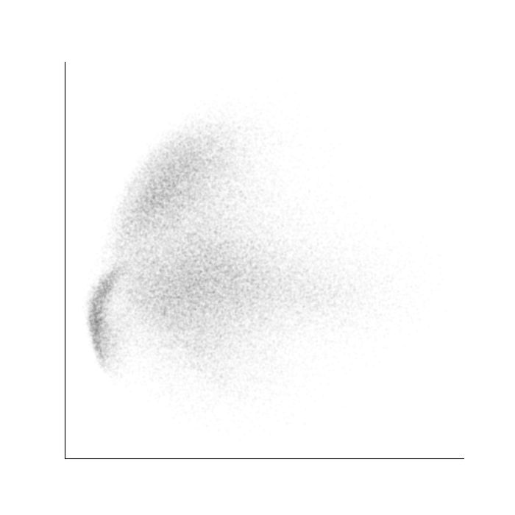
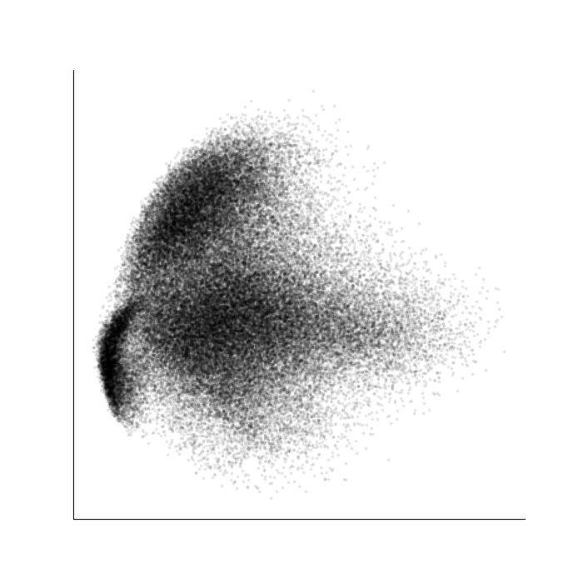
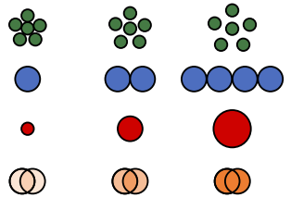
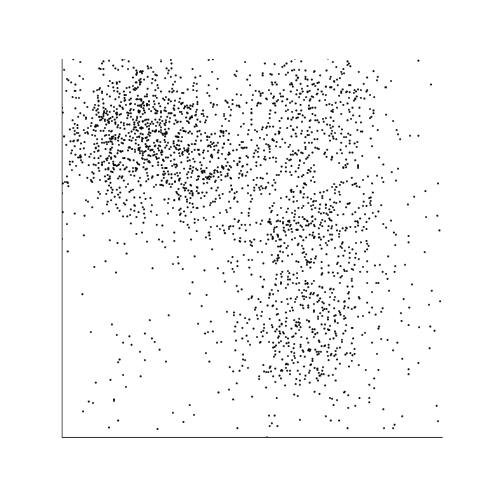

Evaluating the role of data and visual encoding in clustering
Number of data points
Opacity of data points
Size of data points

Slide 6
G. J. Quadri, P. Rosen. “Modeling the Influence of Visual Density on Cluster Perception in Scatterplots Using Topology.” IEEE Transactions on Visualization and Computer Graphics (IEEE VIS), 2021

Slide 7
G. J. Quadri, P. Rosen. “Modeling the Influence of Visual Density on Cluster Perception in Scatterplots Using Topology.” IEEE Transactions on Visualization and Computer Graphics (IEEE VIS), 2021
Notes:
The threshold plot shows that 3 clusters are most clearly visible in the pink, 5% opacity, and green, 10% opacity, scatterplots.

Slide 8
G. J. Quadri, P. Rosen. “Modeling the Influence of Visual Density on Cluster Perception in Scatterplots Using Topology.” IEEE Transactions on Visualization and Computer Graphics (IEEE VIS), 2021
Notes:
3 clusters are significantly less visible in the blue, 1% opacity, scatterplot.

Slide 9
G. J. Quadri, P. Rosen. “Modeling the Influence of Visual Density on Cluster Perception in Scatterplots Using Topology.” IEEE Transactions on Visualization and Computer Graphics (IEEE VIS), 2021
Notes:
Finally, the clusters are not visible at all in the purple, 50% opacity, or orange, 100% opacity, scatterplots.

Slide 10
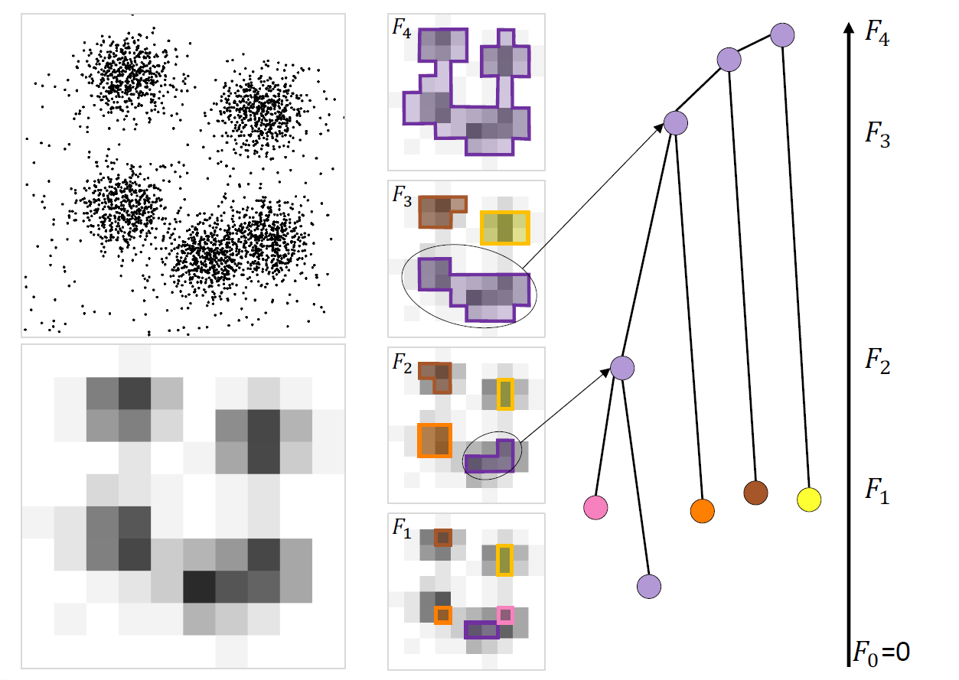
Topology-Based Modeling: Density-based Model (Join Tree)
Notes:
Hence, we consider a second, density-based model, where input is the scatterplot itself.
The density-based model attempts to directly identify the relative visual density at which users will differentiate between clusters.

Slide 11
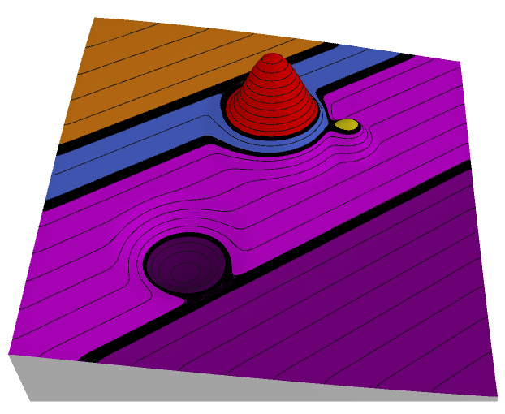

Scalar Field
Notes:
Contour tree is Reeb graph on simply connected domain

Slide 12
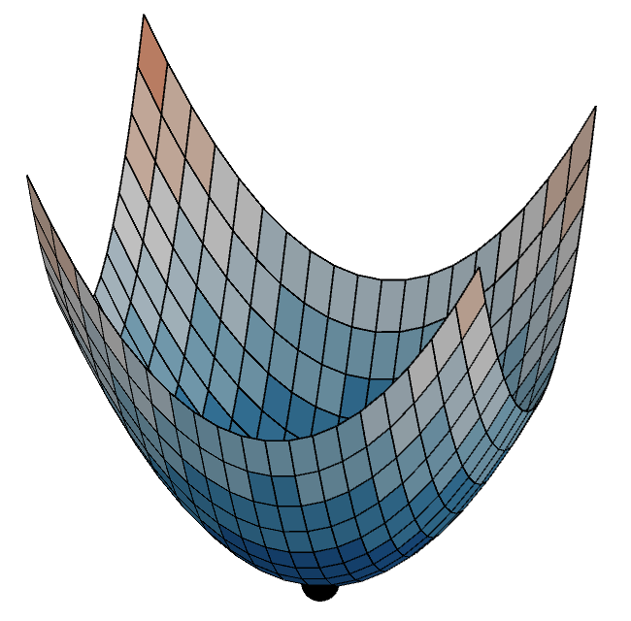
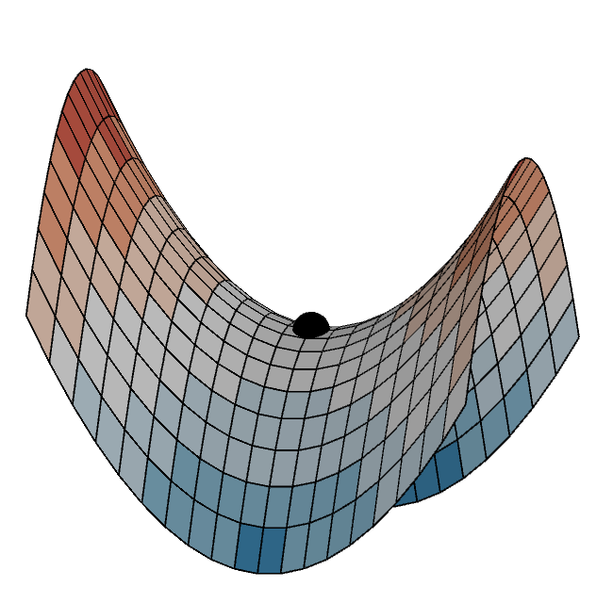
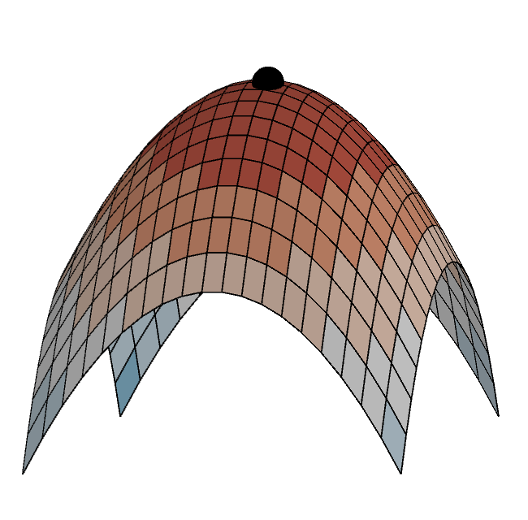
Critical Points
Local Minimum
Saddle Point
Local Maximum

Slide 13
Contour Topology

Slide 14
Contour Topology

Slide 15
Contour Topology

Slide 16
Contour Topology

Slide 17
Contour Topology

Slide 18
Contour Topology

Slide 19
Topology-Based Modeling: Density-based Model (Join Tree)
Visual Saliency of a Cluster (i.e., the persistence)
Notes:
Hence, we consider a second, density-based model, where input is the scatterplot itself.
The density-based model attempts to directly identify the relative visual density at which users will differentiate between clusters.

Slide 20
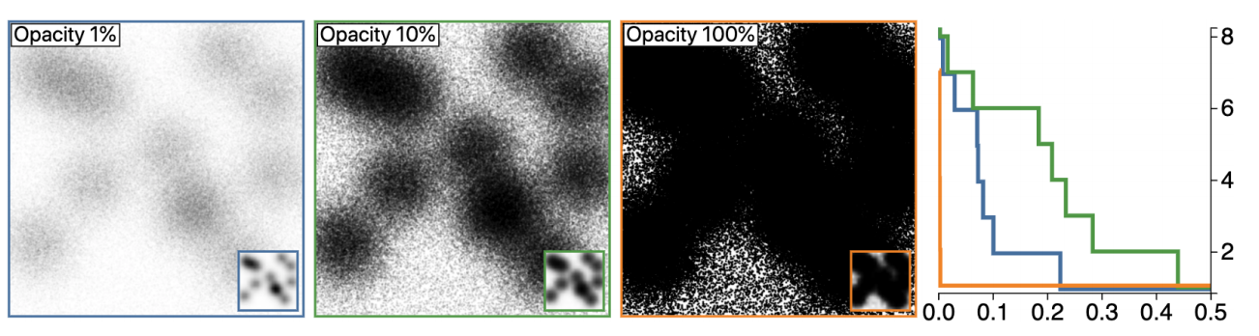
Threshold Plot
number of clusters
visual saliency
Notes:
Which plots visual saliency

Slide 21
Threshold Plot
number of clusters
visual saliency
Notes:
Using this plot, we can see, for example, with the green, 10% opacity plot

Slide 22
Prediction Accuracy
3 experiments
Over 100 subjects
Without model
Density-based model
frequency
estimation error
G. J. Quadri, P. Rosen. “Modeling the Influence of Visual Density on Cluster Perception in Scatterplots Using Topology.” IEEE Transactions on Visualization and Computer Graphics (IEEE VIS), 2021
Notes:
Against the frequency of occurrence.

Slide 23
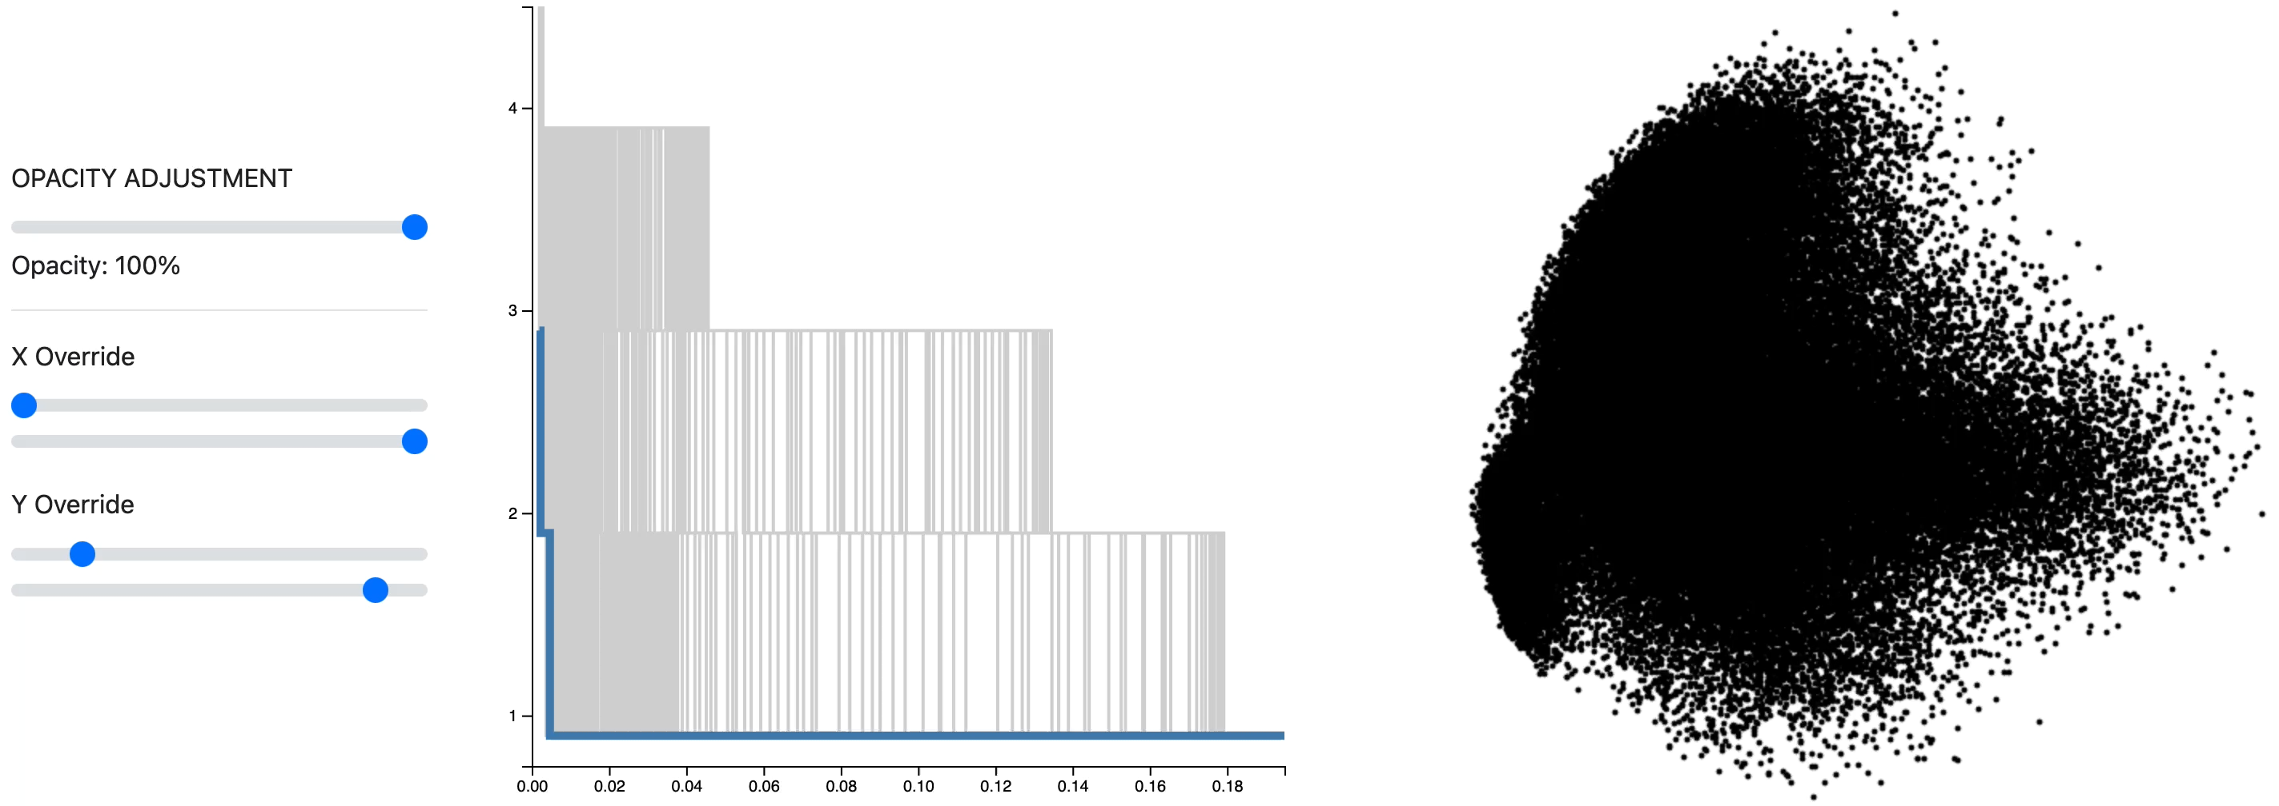
Example: Varying the opacity of points
Notes:
Here we look at varying the opacity of data points, again using the density-based model.
The threshold plots allows for selecting an opacity value that best highlights 3 clusters in the visualization.

Slide 24
Demo
Download @
https://github.com/USFDataVisualization/tdv_workshop_2022/archive/refs/tags/v1.0.2.zip
Windows Unzip, find demos\TopoClusters
Run setup.bat
Run run.bat
Mac/Linux
Command prompt, navigate to demos/TopoClusters
./run.sh

Slide 25
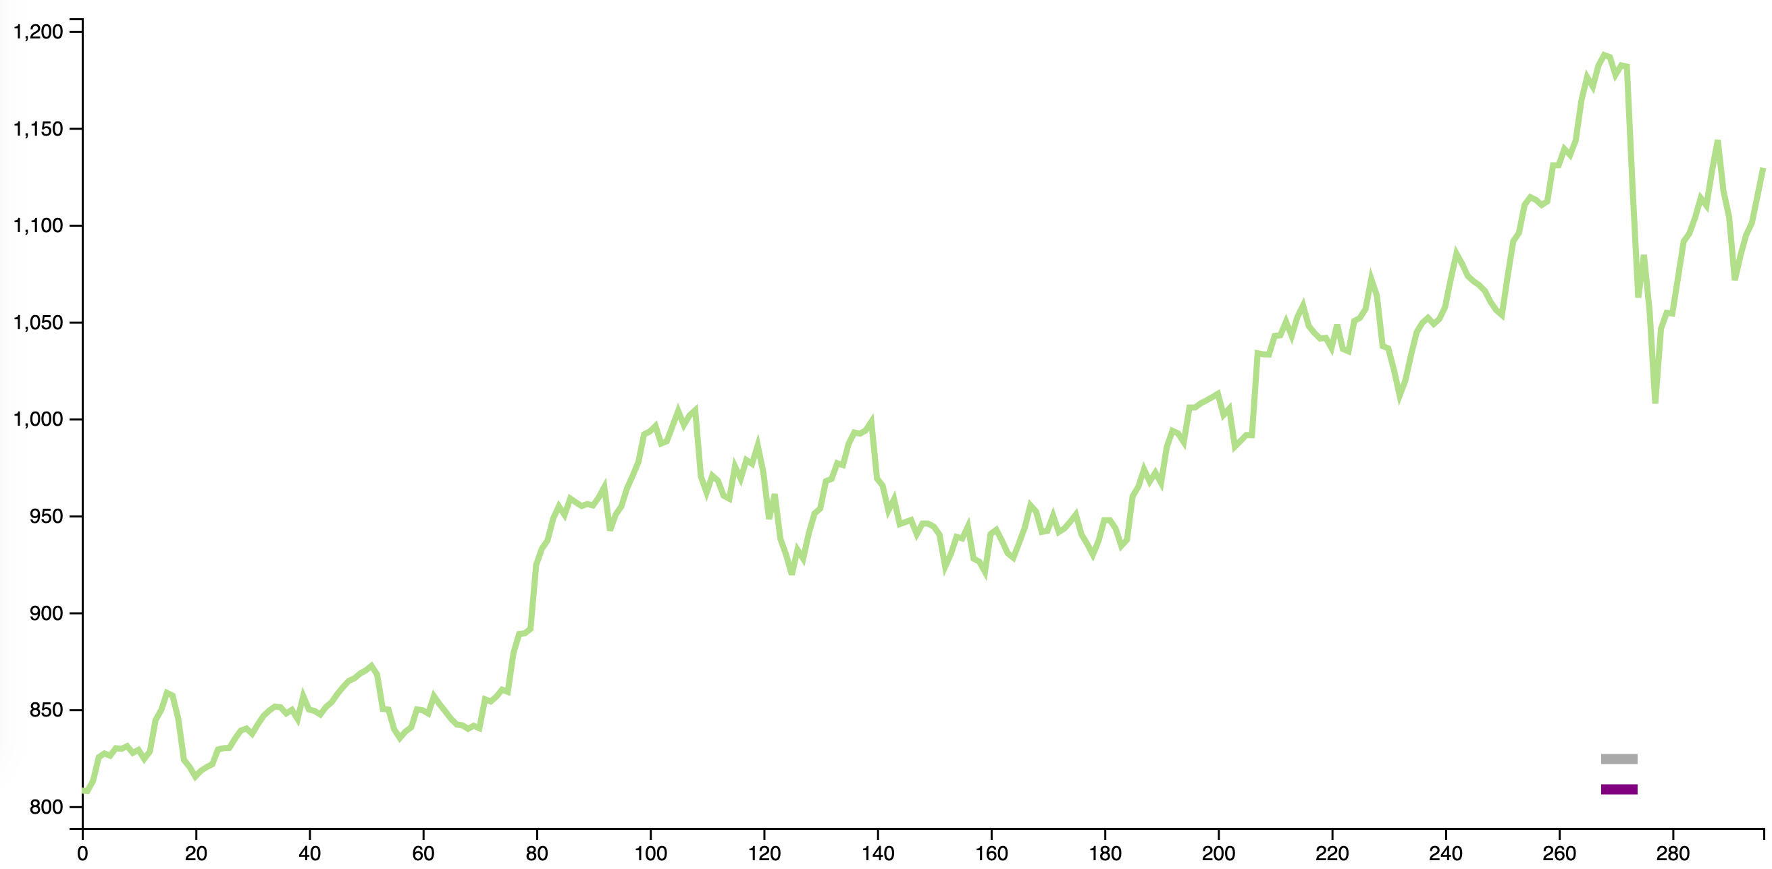
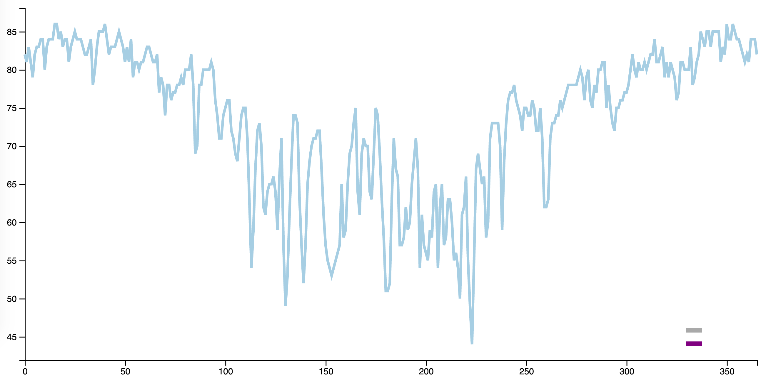
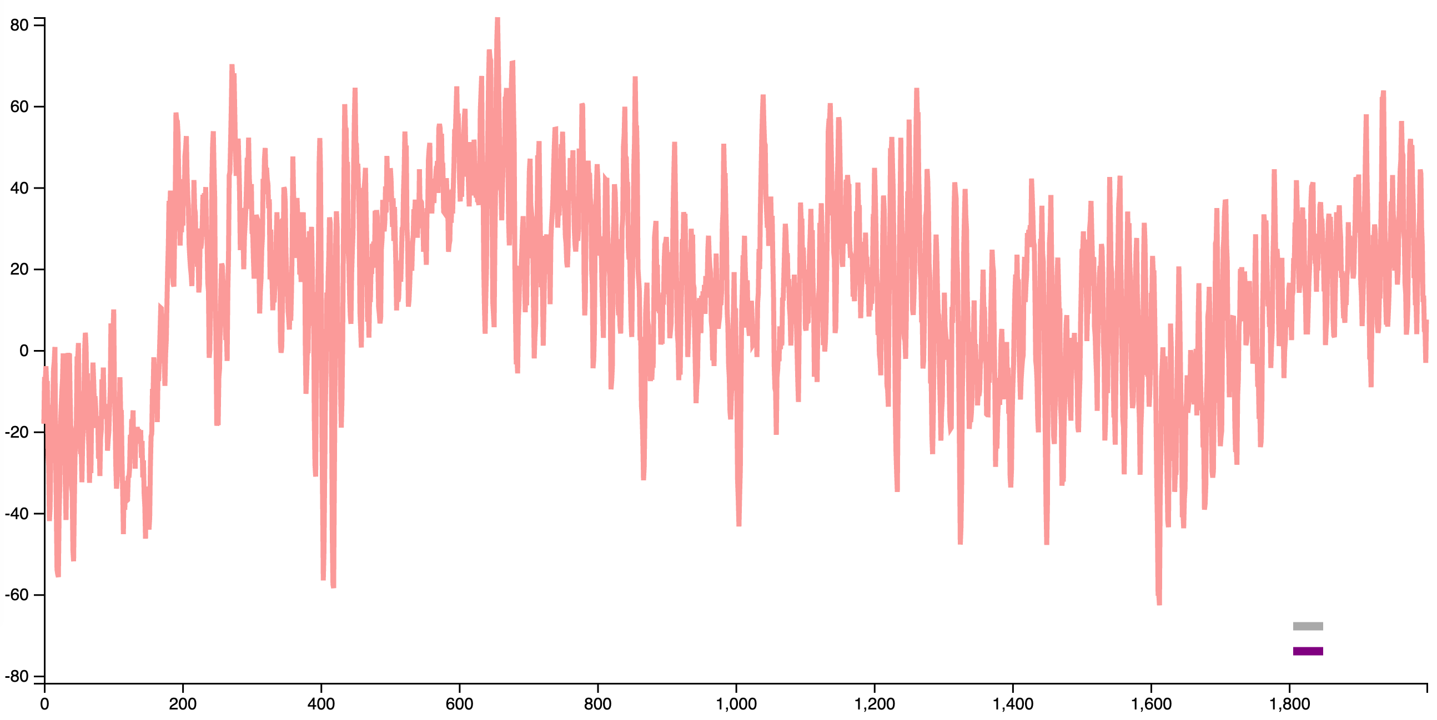
Optimizing Line Chart Designs
Google stock data
Climate data
EEG data
Notes:
We use line charts to visualize many types of data. From stock trends, to weather changes, or from brain activity to radio astronomy frequency.

Slide 26
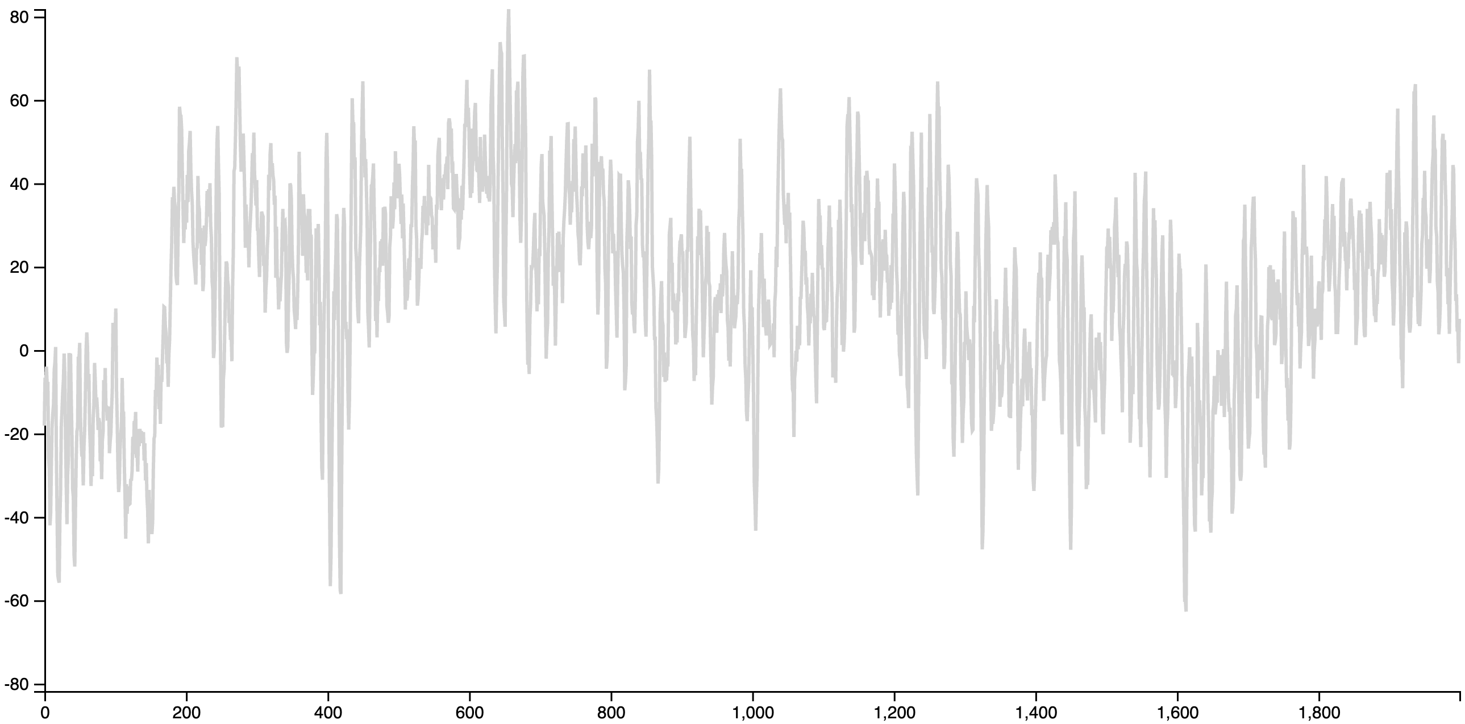
line chart clutter makes analysis tasks difficult
What are the values of the most prominent peaks in the dataset?
EEG data
Notes:
But due to the sheer size of data, we often find that our line charts can be cluttered or noisy, making certain visual analysis tasks difficult. For example, trying to identify the top 3 peaks in this EEG dataset is particularly hard given the number of data points on our line chart.

Slide 27
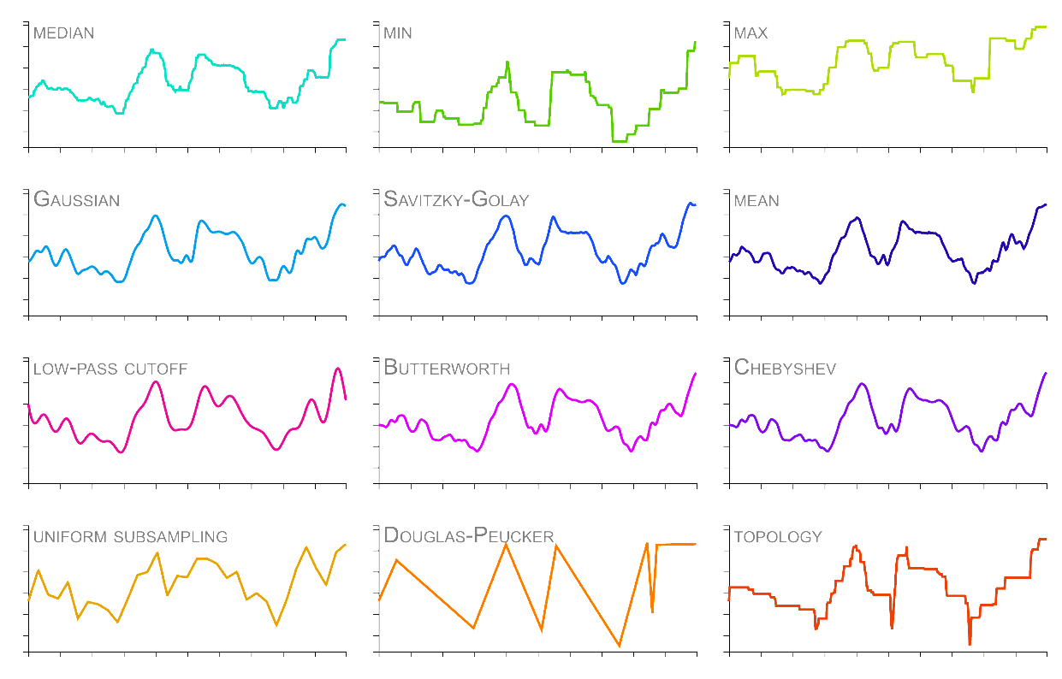
Line Smoothing Can Help!
Notes:
Smoothing the line can help with clutter and noise.
However, there are many techniques available for smoothing, and while the results they produce may look similar, each preserves different properties of the data.

Slide 28
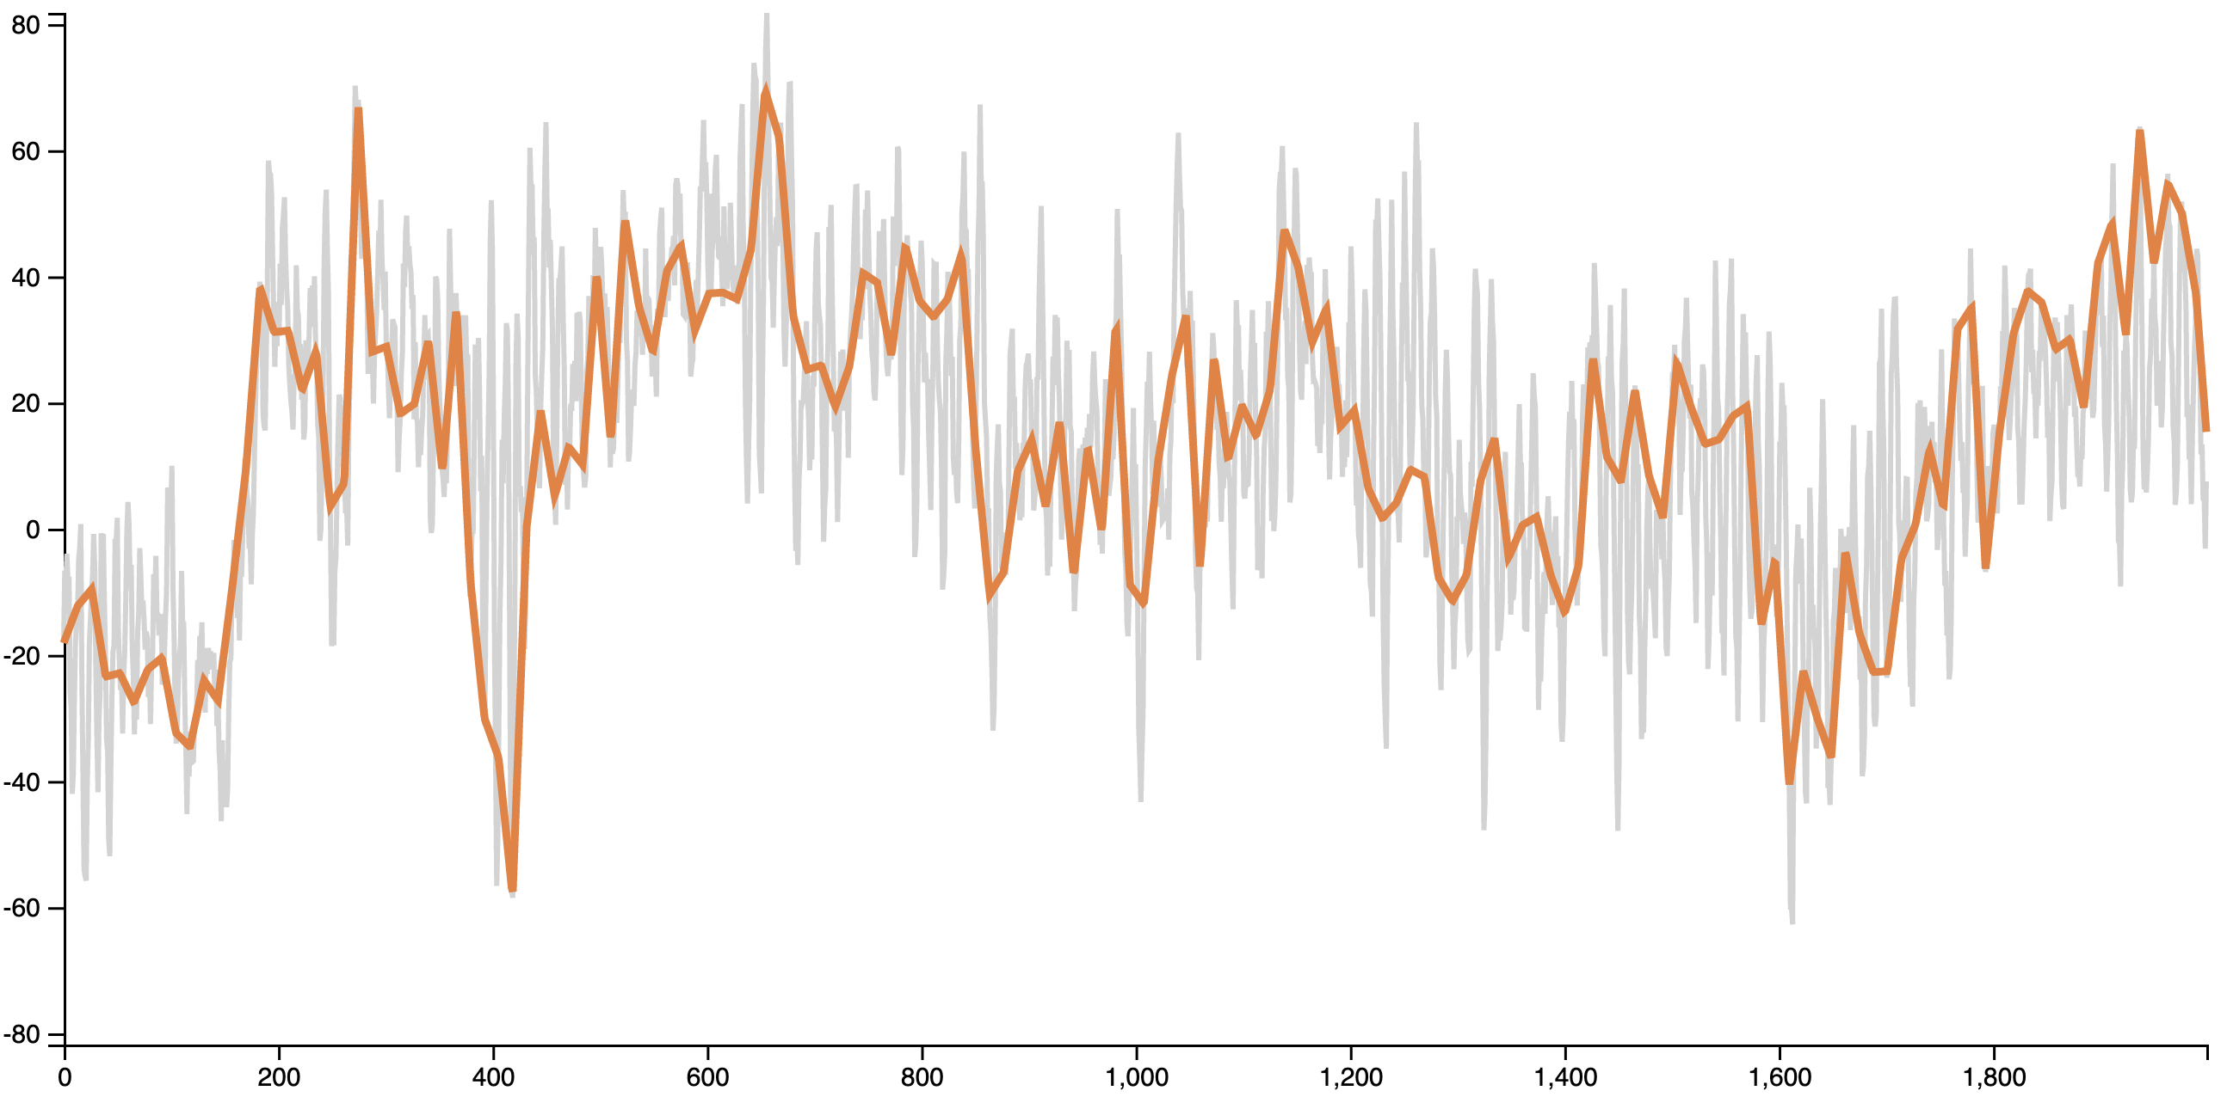
Line Smoothing Can Help?
Original Line
What are the values of the most prominent peaks in the dataset?
Uniform Subsampling
EEG data
Notes:
Except… when I used subsampling on my data, it didn’t preserve the original top 3 peaks from the chart!

Slide 29
Many Popular Smoothing Techniques Don’t Consider Critical Points!
Notes:
In fact, MANY popular smoothing techniques unintentionally remove key critical points. If being able to identify these points is important to you when smoothing a line chart, the method we choose should retain the most prominent peaks from the input data. However, this is not always a guarantee!

Slide 30
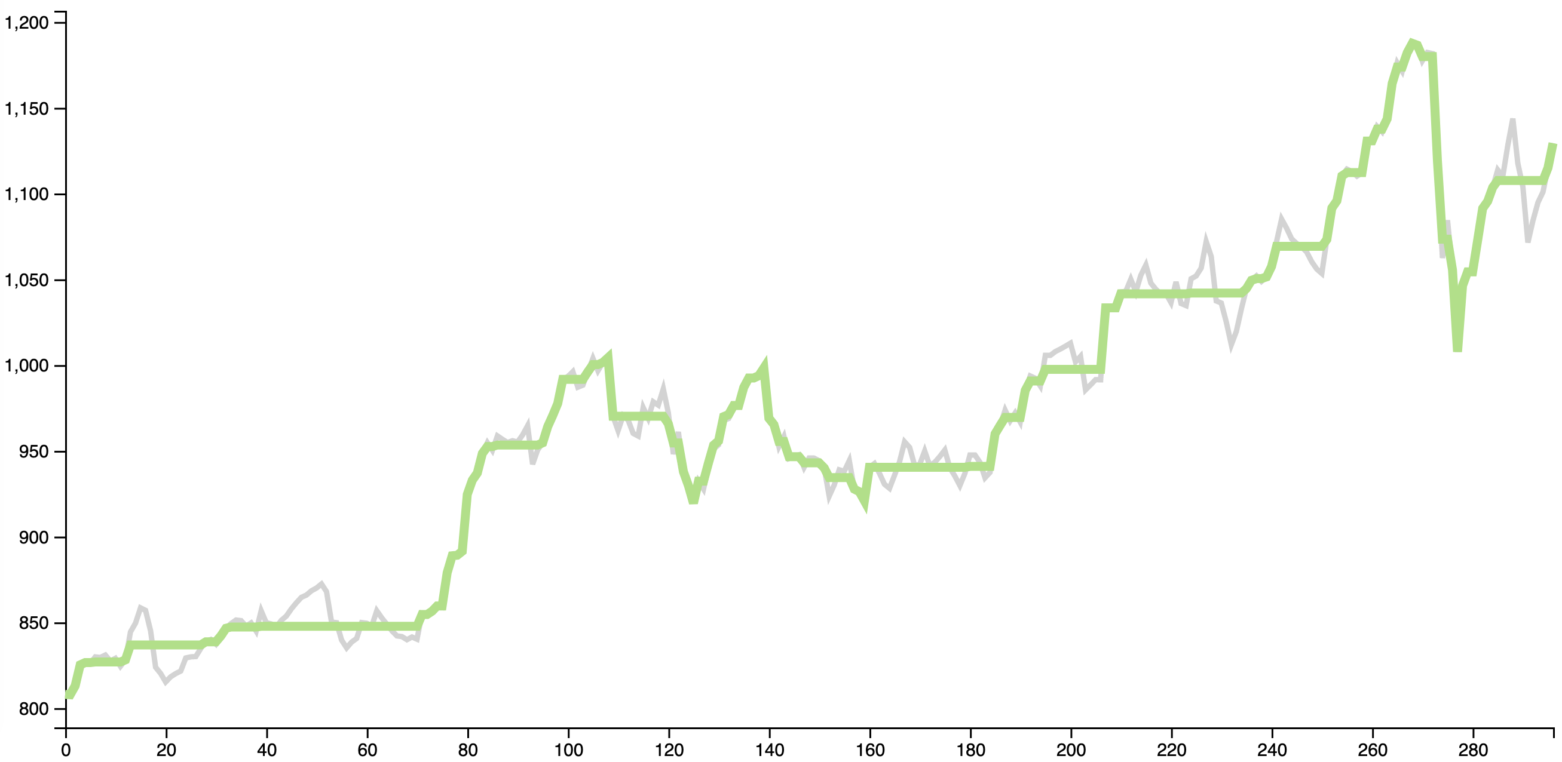
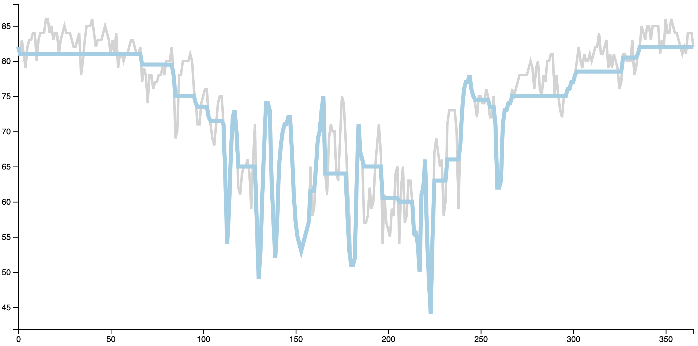
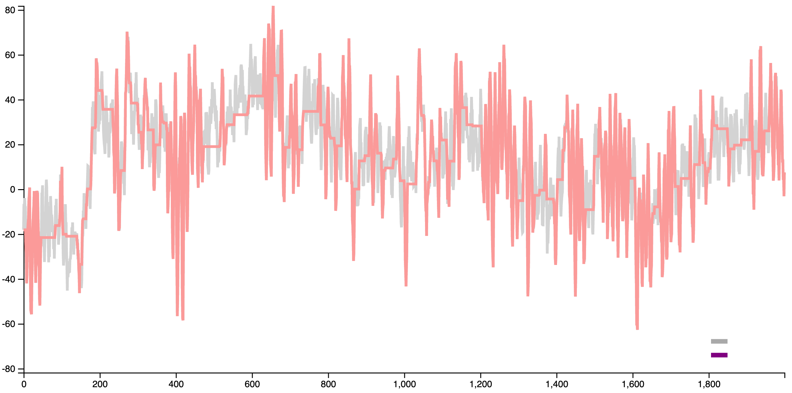
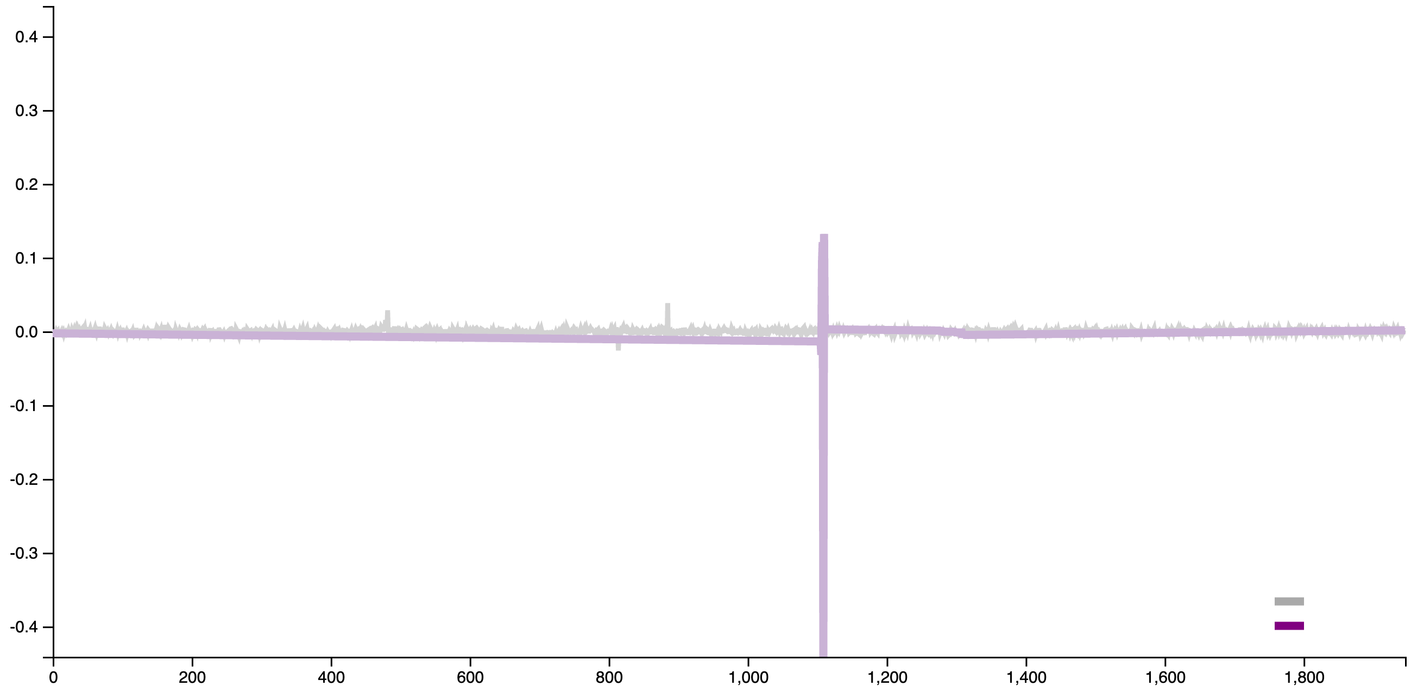
Topology-based Smoothing Retains Critical Points
Original Line
Original Line
TopoLines
TopoLines
Google stock data
Climate data
Original Line
Original Line
TopoLines
TopoLines
EEG data
Radio astronomy data
P. Rosen, A. Suh, C. Salgado, M. Hajij. “TopoLines: Topological Smoothing for Line Charts.” EuroVis Short Papers, 2020.
Notes:
To address the weakness of prior approaches, we created TopoLines. TopoLines is a method for smoothing line charts that leverages techniques from Topological Data Analysis. TopoLines identifies the most prominent peaks in the data and smooths lines by removing the least important peaks. TopoLines also minimizes the residual error between peaks, retaining as much detail from the input data as possible.

Slide 31
Start with our input data
P. Rosen, A. Suh, C. Salgado, M. Hajij. “TopoLines: Topological Smoothing for Line Charts.” EuroVis Short Papers, 2020.
Notes:
Let’s begin with this simple line as our input data.

Slide 32
Identify the critical points using a Join Tree
P. Rosen, A. Suh, C. Salgado, M. Hajij. “TopoLines: Topological Smoothing for Line Charts.” EuroVis Short Papers, 2020.
Notes:
The first step is identifying the critical points, or local minima and maxima. We pair the critical points together using a merge tree. For more details on this calculation, please refer to the paper.

Slide 33
Pair critical points and measure persistence
high persistence
medium persistence
low persistence
P. Rosen, A. Suh, C. Salgado, M. Hajij. “TopoLines: Topological Smoothing for Line Charts.” EuroVis Short Papers, 2020.
Notes:
The persistence is calculated for each extrema pair and we rank them from lowest to highest persistence. Pairs with high persistence have important critical points, so TopoLines preserves the highest persistence peaks during smoothing.

Slide 34
Smoothing the output
X
X
Remove the critical pairs below threshold
Reconstruct the line via isotonic regression
TopoLines minimizes the residual error by using isotonic regression--modifying the original line as little as possible
P. Rosen, A. Suh, C. Salgado, M. Hajij. “TopoLines: Topological Smoothing for Line Charts.” EuroVis Short Papers, 2020.
Notes:
When we remove pairs for smoothing, we have to reconstruct the line. TopoLines minimizes the residual error by using isotonic regression, which is a monotonic regression technique that minimizes the least square error. By using isotonic regression, we ensure that the original line is modified as little as possible during smoothing.

Slide 35
Topology-based Smoothing Retains Critical Points
Original Line
Original Line
TopoLines
TopoLines
Google stock data
Climate data
Original Line
Original Line
TopoLines
TopoLines
EEG data
Radio astronomy data
P. Rosen, A. Suh, C. Salgado, M. Hajij. “TopoLines: Topological Smoothing for Line Charts.” EuroVis Short Papers, 2020.
Notes:
To address the weakness of prior approaches, we created TopoLines. TopoLines is a method for smoothing line charts that leverages techniques from Topological Data Analysis. TopoLines identifies the most prominent peaks in the data and smooths lines by removing the least important peaks. TopoLines also minimizes the residual error between peaks, retaining as much detail from the input data as possible.

Slide 36
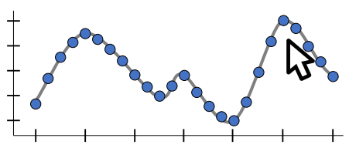
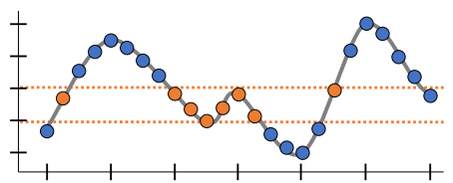
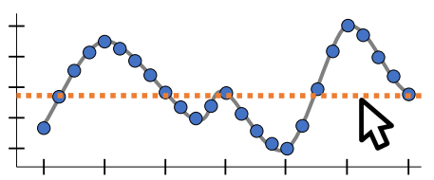
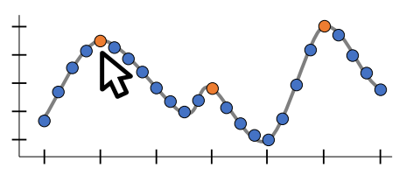
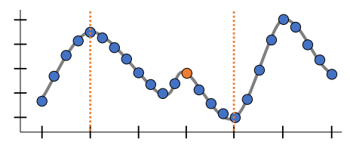
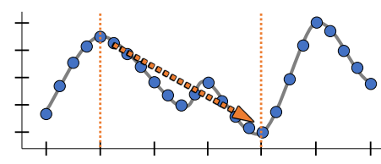
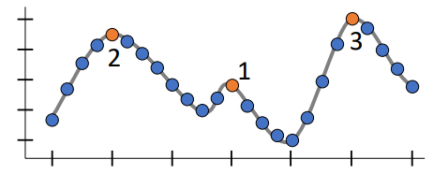
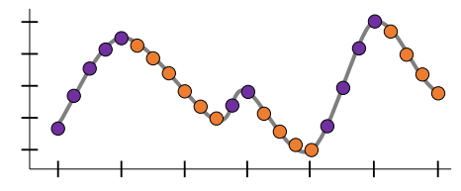
Low-Level Task Taxonomy for Line Charts
Retrieve Value Determine Range Compute Derived Value
Find Extrema Find Anomalies Characterize Distribution
Sort Cluster Trends/Points
P. Rosen, G. J. Quadri. “LineSmooth: An Analytical Framework for Evaluating the Effectiveness of Smoothing Techniques on Line Charts.” IEEE Transactions on Visualization and computer Graphics (IEEE VAST), 2021

Slide 37
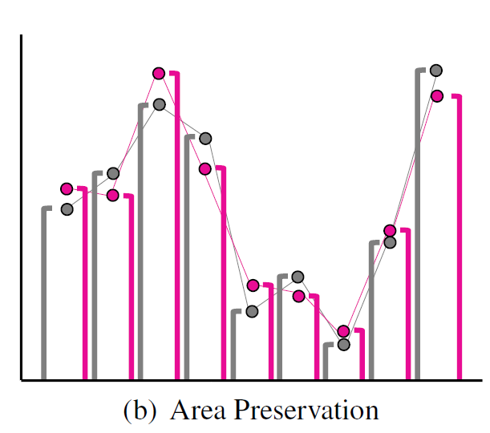
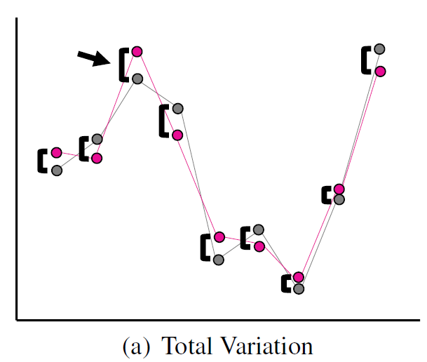
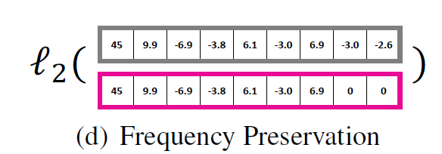
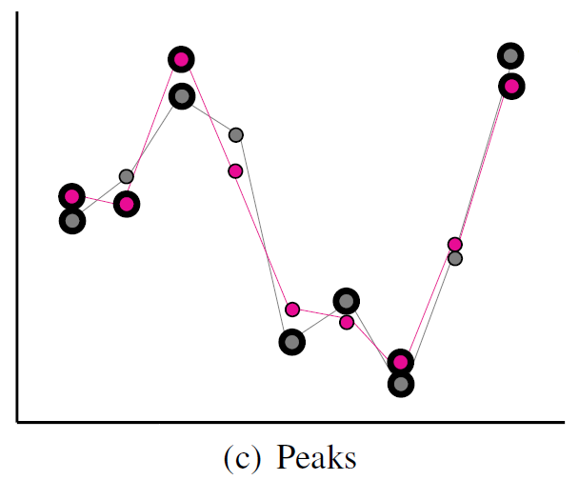
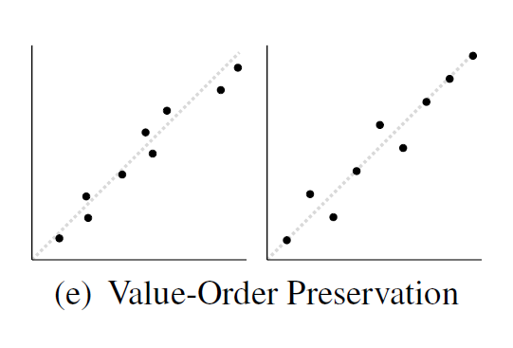
Analytical Measures of Effectiveness using statistical, spectral, geometrical, and topological properties
Retrieve Value
Compute Derived Value
Determine Range
Characterize Distribution
Find Extrema
Sort
Find Anomalies
Cluster Trends/Points
P. Rosen, G. J. Quadri. “LineSmooth: An Analytical Framework for Evaluating the Effectiveness of Smoothing Techniques on Line Charts.” IEEE Transactions on Visualization and computer Graphics (IEEE VAST), 2021

Slide 38
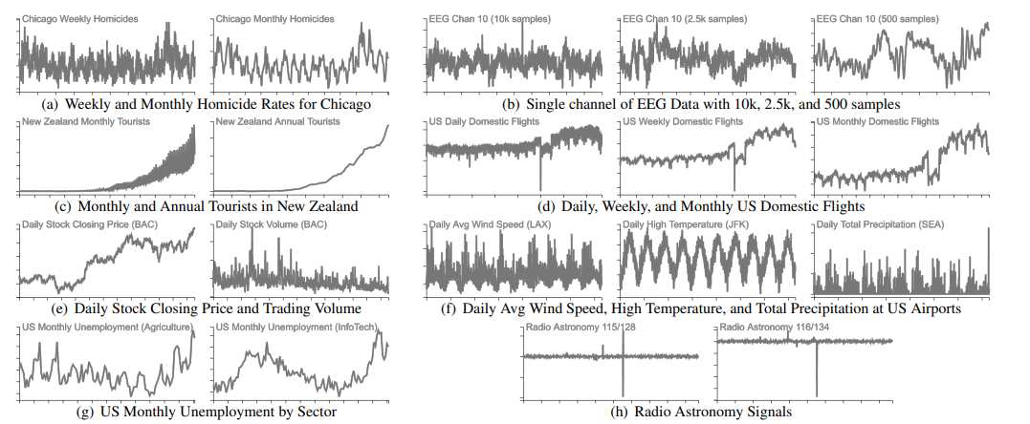


Use statistical, geometrical, and topological properties to rank the effectiveness of methods by task
P. Rosen, G. J. Quadri. “LineSmooth: An Analytical Framework for Evaluating the Effectiveness of Smoothing Techniques on Line Charts.” IEEE Transactions on Visualization and computer Graphics (IEEE VAST), 2021
Notes:
Datasets.
Ranking for each task…
Grades for the Efficacy of Different Smoothing Methods. Methods are graded by the frequency of being ranked in the top 3 for all 80 datasets. A: > 75%; B: 50% −75%; C: 25% −50%; D: 5% −25%

Slide 39
Use statistical, geometrical, and topological properties to rank the effectiveness of methods by task
P. Rosen, G. J. Quadri. “LineSmooth: An Analytical Framework for Evaluating the Effectiveness of Smoothing Techniques on Line Charts.” IEEE Transactions on Visualization and computer Graphics (IEEE VAST), 2021
Notes:
Datasets.
Ranking for each task…
Grades for the Efficacy of Different Smoothing Methods. Methods are graded by the frequency of being ranked in the top 3 for all 80 datasets. A: > 75%; B: 50% −75%; C: 25% −50%; D: 5% −25%

Slide 40
Use statistical, geometrical, and topological properties to rank the effectiveness of methods by task
P. Rosen, G. J. Quadri. “LineSmooth: An Analytical Framework for Evaluating the Effectiveness of Smoothing Techniques on Line Charts.” IEEE Transactions on Visualization and computer Graphics (IEEE VAST), 2021
Notes:
Datasets.
Ranking for each task…
Grades for the Efficacy of Different Smoothing Methods. Methods are graded by the frequency of being ranked in the top 3 for all 80 datasets. A: > 75%; B: 50% −75%; C: 25% −50%; D: 5% −25%

Slide 41
Use statistical, geometrical, and topological properties to rank the effectiveness of methods by task
P. Rosen, G. J. Quadri. “LineSmooth: An Analytical Framework for Evaluating the Effectiveness of Smoothing Techniques on Line Charts.” IEEE Transactions on Visualization and computer Graphics (IEEE VAST), 2021
Notes:
Datasets.
Ranking for each task…
Grades for the Efficacy of Different Smoothing Methods. Methods are graded by the frequency of being ranked in the top 3 for all 80 datasets. A: > 75%; B: 50% −75%; C: 25% −50%; D: 5% −25%

Slide 42
Demo
Download @
https://github.com/USFDataVisualization/tdv_workshop_2022/archive/refs/tags/v1.0.2.zip
Windows Unzip, find demos\TopoLines
Run setup.bat
Run run.bat
Mac/Linux
Command prompt, navigate to demos/TopoLines
./run.sh

Slide 43
Break

Slide 44


Visualization of Graphs as Node-Link Diagrams
Force-directed diagram of post-rebuild site
Ian Lurie, www.portent.com
Force-directed layout of the U.S. Interstate System
Mkinde, www.ideasillustrated.com

Slide 45

Graph Drawing Challenges
hairballs indistinguishable graph structure

Slide 46



Graph + TDA = Better Graph Visualizations
+
=
persistence barcode
(via persistent homology)

Slide 47




Mapping a Graph to Persistent Homology
Graph
Metric Space Embedding
Persistent Homology Calculations
Graph Visualization
M. Hajij, B. Wang, C. Scheidegger, & P. Rosen. “Visual detection of structural changes in time-varying graphs using persistent homology.” IEEE Pacific Visualization Symposium (PacificVis), 2018.

Slide 48

Edge Complex
$$EDGE(t)=\left\{\left(e_{i},w_{i}\right):w_{i}≥ t\right\}$$
B. Doppalapudi, B. Wang, & P. Rosen. “Untangling Force-Directed Layouts Using Persistent Homology.” Submitted to IEEE VIS 2022.

Slide 49

Edge Filtration
B. Doppalapudi, B. Wang, & P. Rosen. “Untangling Force-Directed Layouts Using Persistent Homology.” Submitted to IEEE VIS 2022.

Slide 50
Edge Filtration
B. Doppalapudi, B. Wang, & P. Rosen. “Untangling Force-Directed Layouts Using Persistent Homology.” Submitted to IEEE VIS 2022.

Slide 51
Edge Filtration
B. Doppalapudi, B. Wang, & P. Rosen. “Untangling Force-Directed Layouts Using Persistent Homology.” Submitted to IEEE VIS 2022.

Slide 52

Fast Calculation: maximal spanning tree for a weighted graph G
H₀ features formed by edges of the spanning tree
H₁ features formed by non-spanning tree edges
v₄
v₂
e₁ = 3
e₃ = 4
e₄ = 1
v₁
e₂ = 2
v₃
persistence barcode
spanning tree of G
G = (V, E, w )
B. Doppalapudi, B. Wang, & P. Rosen. “Untangling Force-Directed Layouts Using Persistent Homology.” Submitted to IEEE VIS 2022.

Slide 53

Force-directed layouts
Converted into a system of attractive springs and repulsive forces

Slide 54

Force-Directed Layouts
randomly initialize node positions
iteratively solve physically-based system

Slide 55
Typical Forces Used

Slide 56
Force-Directed Layouts
randomly initialize node positions
iteratively solve physically-based system

Slide 57

Improving Initialization
B. Doppalapudi, B. Wang, & P. Rosen. “Untangling Force-Directed Layouts Using Persistent Homology.” To be submitted to IEEE VIS 2022.

Slide 58

Improving Initialization

Slide 59
Improving Initialization

Slide 60
Improving Initialization

Slide 61
Force-Directed Layouts
randomly initialize node positions
iteratively solve physically-based system

Slide 62
Improving Interaction: 0-dimensional Persistent Homology Forces (Attractive Nodes)
A. Suh, M. Hajij, B. Wang, C. Scheidegger. & P. Rosen. “Persistent homology guided force-directed graph layouts.” IEEE Transactions on Visualization and Computer Graphics (IEEE InfoVis), 2019.

Slide 63

Improving Interaction: 1-dimensional Persistent Homology Features (elliptical shape)
Original Graph
Parameterized Loop
Target Locations
Apply Force
B. Doppalapudi, B. Wang, & P. Rosen. “Untangling Force-Directed Layouts Using Persistent Homology.” Submitted to IEEE VIS 2022.

Slide 64
Demo
Download @
https://github.com/USFDataVisualization/tdv_workshop_2022/archive/refs/tags/v1.0.2.zip
Windows Unzip, find demos\UntangleFDL
Run run.bat
Mac/Linux
Command prompt, navigate to demos/UntangleFDL
./run.sh

Slide 65

MOG: Mapper on Graphs

Slide 66
Input: An Undirected Graph

Slide 67


Step 1: Apply a Lens/Filter Function
$$f:𝕏→ℝ$$
$$f$$

Slide 68

Filter Function Selection

Slide 69








Step 2: Cover the Domain
$$f:𝕏→ℝ$$
$$𝒰$$
$$f$$
$$b$$
Semi-automatic selection:
select $n$ cover elements
overlap $ε$
$$𝒰_{4}$$
$$𝒰_{3}$$
$$𝒰_{2}$$
$$𝒰_{1}$$
$$a$$

Slide 70




Step 3
Find the Inverse Images (subgraphs)
$${f^{−1}(𝒰}_{4})$$
$${f^{−1}(𝒰}_{3})$$
$${f^{−1}(𝒰}_{2})$$
$${f^{−1}(𝒰}_{1})$$

Slide 71



Step 4
Cluster Subgraphs to form Mapper Nodes by finding connected components or graph clustering (e.g., modularity)
$$N_{1}\left(𝒰\right)$$
$$A$$
$$B$$

Slide 72
Step 5
Use original graph edges across sets, via graph cut
$$N_{1}\left(𝒰\right)$$

Slide 73
Demo
Live Demo
https://ee2a6h-g7h7n4.github.io/MapperOnGraphsDemo/
To load the tool on your own machine
Download/clone and run:
https://github.com/USFDataVisualization/MapperOnGraphs

Slide 74

TopoInVis @ IEEE VIS 2022
Full Paper Deadline: Abstract June 21 / Paper June 25
https://topoinvis-workshop.github.io/2022/

Slide 75







IEEE VIS 2024 – VIS on the Beach!!!
TradeWinds Island Grand Resort Tampa Bay, FL, USA October 12-18, 2024

Slide 76













Current & Former Coauthors, Collaborators, and Students
Research Funding
CAREER: Discovering Structure in Uncertainty: Using Topology for Interactive Visualization of Uncertainty, National Science Foundation (IIS-1845204)
Topological Data Analysis for Large Network Visualization, National Science Foundation (IIS-1513616)
Feasibility of mHealth Technology for Improving Self-Management and Adherence Among Asthmatic Adolescents, National Institutes of Health (NIH-5R34HL145442)
Solutions for Automated Video Deep Fake Detection, Defense Intelligence Agency
Feature Extraction and Visualization through Topological Data Analysis of Spectral Astrophysical Data, National Radio Astronomy Observatory ALMA Development Study Program
Using Persistent Homology to Drive Interactive Graph Drawing, CRA-W Collaborative Research Experiences for Undergraduates (CREU)
STORM: Spatio-Temporal Online Reasoning and Management of Large Data, NSF Data Infrastructure Building Blocks (CIF21 DIBBs OAC-1443046)
Simplifying Network Visualizations Using Topological Data Analysis, NVIDIA Academic Hardware Grant
…and many more

Slide 77
Questions?
Contact:
Paul Rosen prosen@usf.edu http://www.cspaul.com

